Slide 1




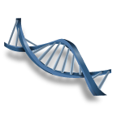
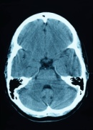


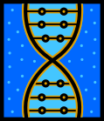



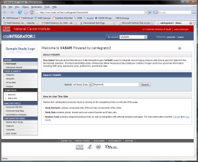
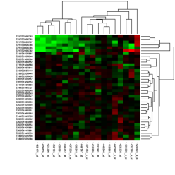
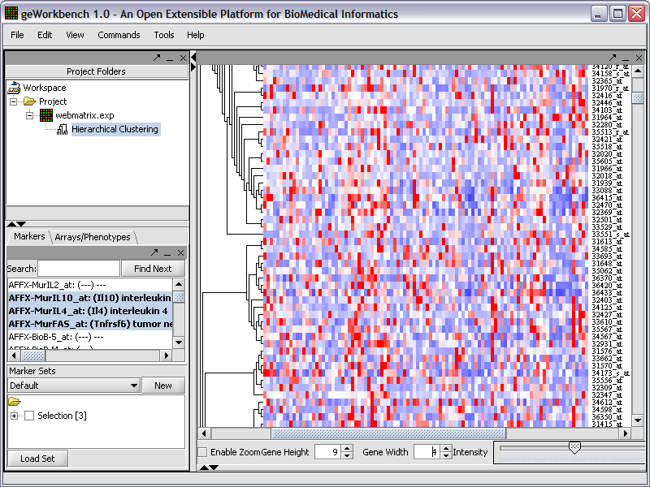
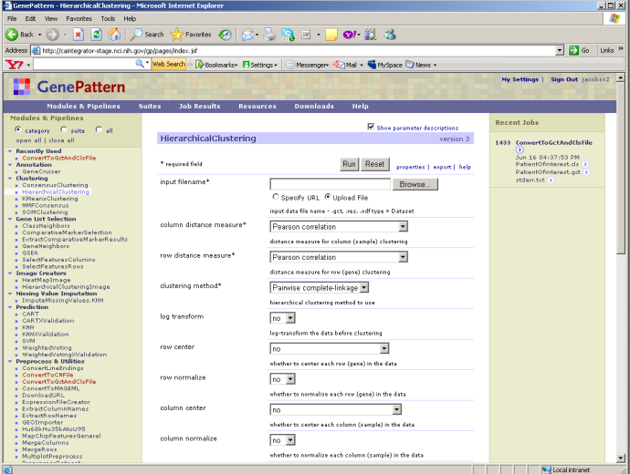
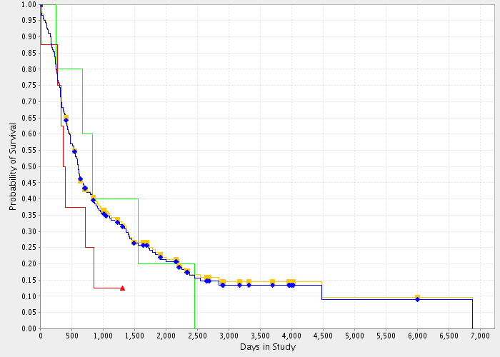
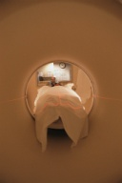
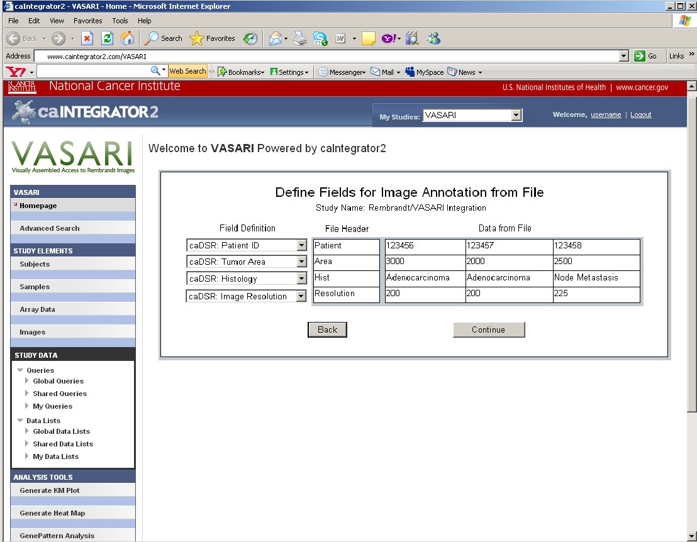
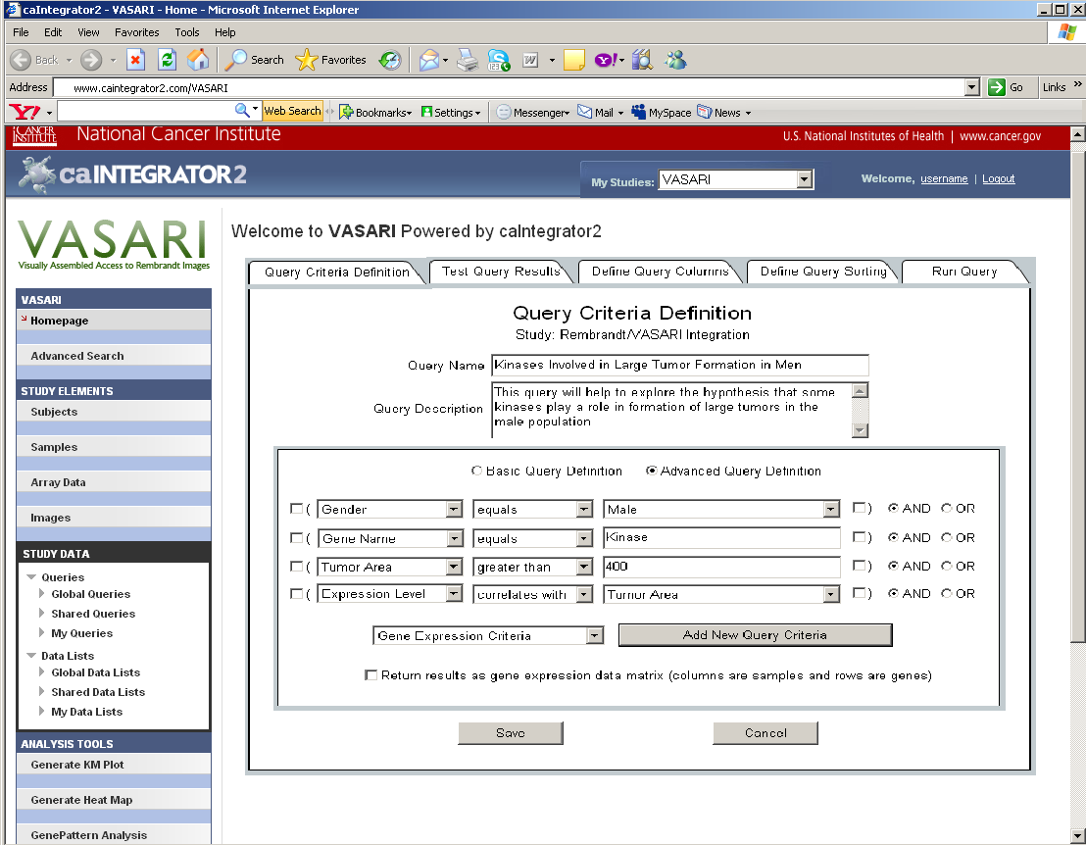
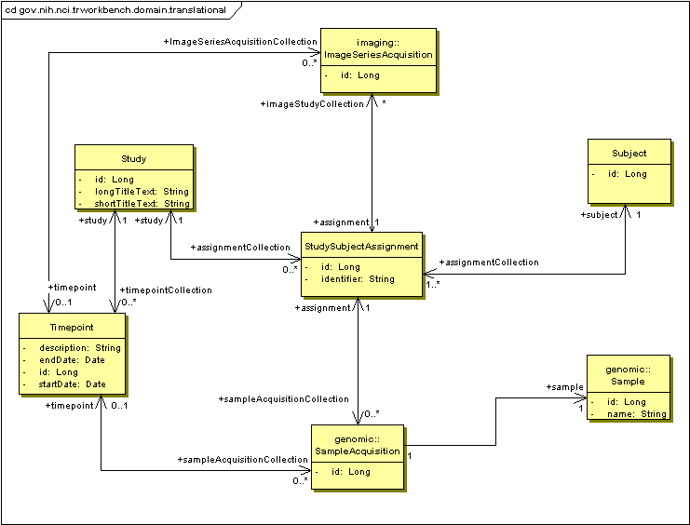
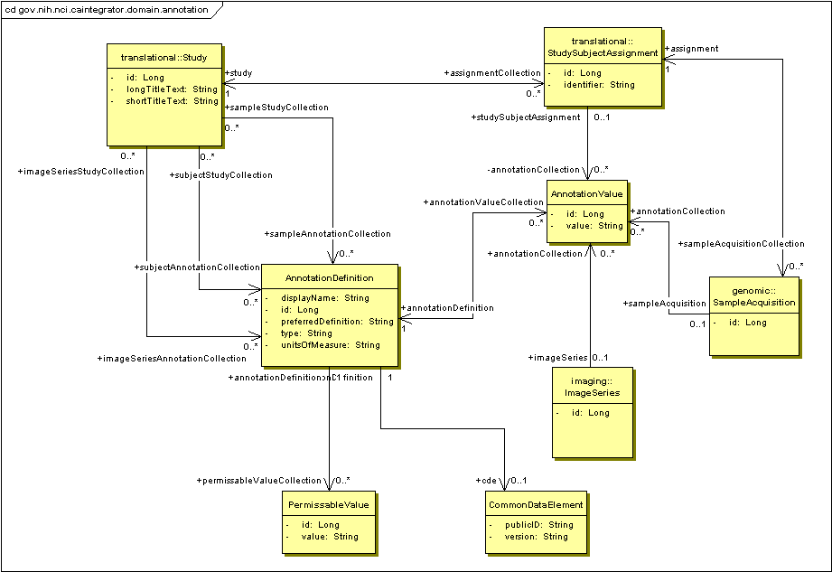

caIntegrator2: Translational research tool for the 21st Century
Will FitzHugh⁵, Shine Jacobs⁵, Eric Tavela⁵, Huaitian Liu⁴, JP Marple5 , TJ Andrews⁶, Ngoc Nguyen, Anand Basu¹, Cliff Wong1
NCI¹, SAIC⁴, 5AM Solutions⁵, ScenPro⁶
Abstract
Use Cases
CaIntegrator2 is a software package that allows users to set up their own custom caBIG®-compatible translational research web portals that bring together heterogeneous clinical, microarray, and medical imaging data. Rolling out these custom portals does not require any custom software development and is accomplished through a web interface. The resulting caIntegrator2 portals enable researchers to execute, save and share queries.
CTODS
(Clinical Trials Object Data System)
Clinical Data
OR
caIntegrator2
Query and Browse Study Data: Research Investigators can browse and filters lists of study objects, such as patients, image series and genes. They can also run and create queries that can produce lists of any object and associated annotation, in a specified order. Query results can be saved or exported to spreadsheets.
Clinical Annotation Spreadsheet
Description
caArray
Genomic Data
(mRNA expression, array CGH)
NCIA
(National Cancer Imaging Archive)
Image Annotation Spreadsheet
Caintegrator2 uses existing analytical services available on caGrid such as GenePattern and BioConductor to perform data analysis on the integrated study data, and also has built-in facilities for analyzing clinical survival data. It takes advantage of caDSR to map study data to well-defined datatypes. It uses caGrid API’s to pull data from caBIG applications such as caArray, NBIA and caTissue. CaIntegrator2 is well-suited for analysis and dissemination of data from integrative translational research studies.
More..desc..
Imaging Data
GeWorkbench
GenePattern
Patients in Study
Kaplan-Meier Plots
Perform Analysis: Data from caIntegrator2 can be sent to other software packages for more sophisticated analysis. GenePattern and GeWorkbench are available for clustering and classification analysis and several other analysis tools are built in, including Kaplan-Meier survival plots.
Deploy Study: The Study Manager defines the sources of data for a new study. The data is then accessed over the Grid or uploaded from files. The Study Manager defines relationships between patients and samples so that data can be compared properly across the data sources. The Study Manager also defines mapping of uploaded annotation fields to caDSR datatypes.
Web Interface
Object Model
Deploy Study: This page allows the Study Manager to map each uploaded clinical data field to a caDSR datatype. The detailed datatype description, field type (number, date, yes/no, etc.) and allowable values can then be read from caDSR and used to validate the data.
Manage Queries: This page allows the Study Manager to create queries that can be shared with all researchers who have access to the study. These queries can access all fields from all data sources and complex queries can be built up from logical combinations of simpler queries. The queries can also look for correlation relationships such as genes that are up-regulated in a certain tumor type determined by imaging.
Future Directions
Translation Data Model: This object model shows the relationship between study subjects (patients) and the genomic and imaging data that is acquired from them. In addition, multiple timepoints can be defined for a study so that imaging and genomic data can be gathered multiple times. An example of timepoints would be ‘At Diagnosis’ and ‘After Treatment’.
Annotation Data Model: This object model shows how annotations are stored. Annotations can be associated with patients, genomic samples and image series. The Common Data Element object defines a relationship with a caDSR datatype if an appropriate one can be found.
Continued integration of images with other molecular technologies.
Correlation of prospective and retrospective clinical data with image data for using images as surrogate markers to predict treatment responses.
Coordinate with imaging communities to improve image analysis and feature prediction outcomes based on algorithms.
caBIG™ Annual Meeting July 20-22, 2009, Washington DC

